Slide 1
SCADA BASED
THERMAL POWER PLANT
Presented By : Vivek Rawat & Vaibhav Singh
BSA College of Engineering & Technology , Mathura

Slide 2
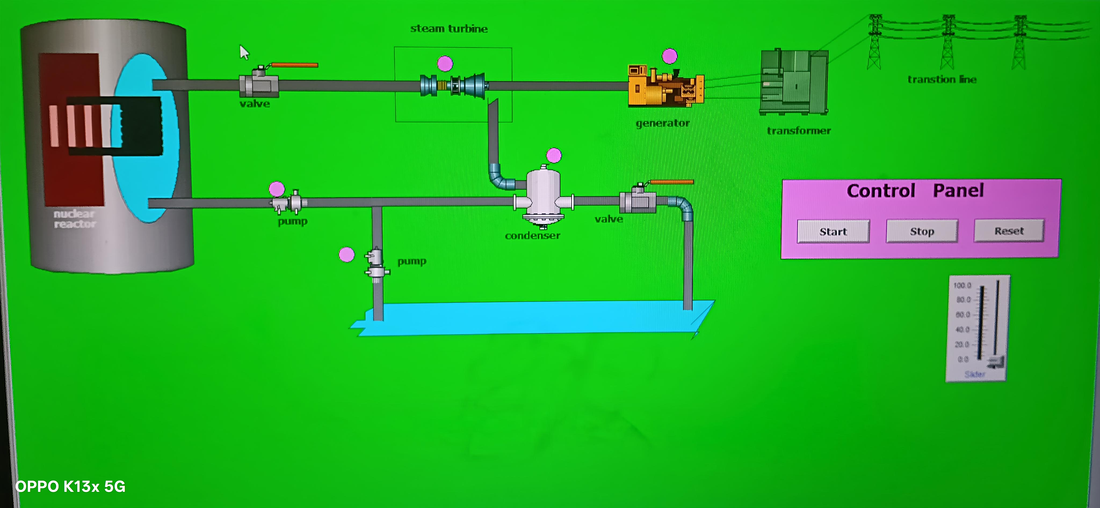
1. Introduction
A thermal power plant converts fuel energy into electrical energy.
SCADA provides centralized monitoring, supervisory control, alarms and data logging.
Automation improves reliability, safety, process visibility and operator response.
The project presents a conceptual SCADA system for a thermal power plant.

Slide 3
2. Objectives
:- Monitor temperature, pressure, flow, level, speed,vibration and electrical parameters.
:- Collect field data through PLC/RTU and industrial communication networks.
:- Provide HMI screens, alarms, trends and historical data.
:- Improve operational efficiency, safety and maintenance decisions.

Slide 4
3. Working Principle
Coal Handling
Boiler
Steam Turbine
Generator
Transformer
Grid
Cooling Tower
Condenser

Slide 5
4. Thermal Power Plant Block Diagram
Fuel → Boiler
Boiler → Superheated Steam
Steam → Turbine
Turbine → Generator
Generator → Transformer
Transformer → Transmission Grid

Slide 6
5. Major Components
Boiler
Produces high-pressure steam
Turbine
Converts steam energy into mechanical power
Generator
Produces electrical energy
Condenser
Condenses exhaust steam
Cooling Tower
Rejects waste heat
Transformer
Steps up voltage

Slide 7
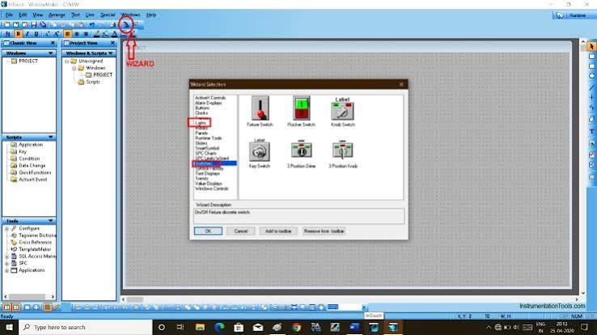
6. What is SCADA?
:- SCADA stands for Supervisory Control and Data Acquisition.
:- It collects real-time information from field devices and presents it to operators.
:- Main elements are sensors, PLC/RTU, communication network, SCADA server, . HMI and historian.
:- SCADA supports supervisory control, alarms, trends and reports.

Slide 8
7. SCADA Architecture
HMI / Operator Station
SCADA Server
Historian
Industrial Network
PLC / RTU
Boiler
Turbine
Generator
Water System
Switchyard
Sensors → PLC/RTU → Network → SCADA → HMI / Historian

Slide 9
8. Sensors & Instrumentation
:- Temperature: RTD and thermocouple.
:- Pressure: steam, boiler drum and condenser pressure transmitters.
:- Flow: steam, feedwater, fuel and cooling-water flow.
:- Level: boiler drum, tanks and condenser hotwell.
:- Speed and vibration: turbine-generator condition monitoring.
:- Actuators: control valves, dampers, pumps and motor drives.

Slide 10
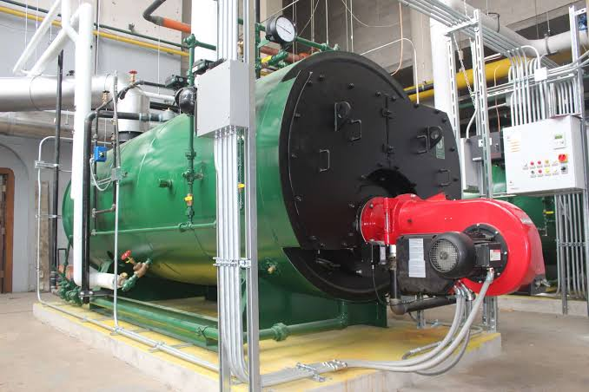
9. Boiler Monitoring & Control
:- Monitor drum level, steam pressure, steam temperature and feedwater flow.
:- Maintain combustion conditions through fuel-air control.
:- Three-element drum-level control can use level, steam flow and feedwater flow.
:- SCADA displays boiler status, trends and alarm conditions.

Slide 11

10. Turbine & Generator Monitoring
:- Turbine: speed, inlet pressure, temperature, exhaust pressure and vibration.
:- Generator: voltage, current, frequency, MW, MVAr and power factor.
:- Protection and interlocks respond to dangerous conditions.
:- SCADA provides centralized machine-health visibility.

Slide 12
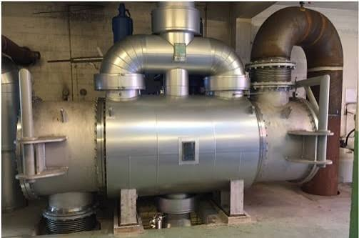
11. Condenser & Cooling System
:- Monitor condenser pressure/vacuum and cooling-water temperature.
:- Monitor cooling-water flow, pump status and cooling-tower fans.
:- Poor condenser vacuum can reduce turbine performance.
:- Alarms help operators identify abnormal cooling conditions quickly.

Slide 13
12. Performance Monitoring – Illustrative Graphs
Steam Pressure Trend
Turbine Vibration Trend
Illustrative project graphs; actual operating limits depend on plant and equipment specifications.

Slide 14
13. Advantages & Limitations
Advantages
Limitations
:- Real-time monitoring
:- Fast fault detection
:- Historical data analysis
:- Better operator decisions
:- Reduced manual logging
:- High initial cost
:- System complexity
:- Cybersecurity risks
:- Sensor/communication failures
:- Legacy-system integration

Slide 15
14. Conclusion
:- SCADA plays an important role in modern thermal power plants by providing real-time monitoring, data acquisition, alarm management and supervisory control.
:- The system improves plant efficiency, safety, fault detection and maintenance planning while reducing manual intervention.
:- With future technologies such as AI, predictive maintenance, digital twins and advanced data analytics, SCADA-based thermal power plants can become more intelligent, efficient and reliable.

Slide 16
THANK YOU !

